Slide 1
Centene Corporation and the National Council on Independent Living Address Gaps in Disability Access – An Award Winning Idea
An Overview of the Centene and NCIL Provider Accessibility Initiative (PAI)

Slide 2
Agenda
Provider Accessibility Initiative
Notes:
Sarah slide

Slide 3
Agenda
Overview of Centene and NCIL
Overview of Barrier Removal Fund (BRF) Activities/Outcomes To Date
Questions
Closing
Notes:
Sarah slide

Slide 4
Company Overviews
Provider Accessibility Initiative
Notes:
Sarah slide

Slide 5
Centene Overview
St. Louis-based company founded in Milwaukee in 1984
45,400 employees, 14.1 million members, 2 international markets
31 states with government-sponsored healthcare programs
Medicaid (27 states)
Marketplace (20)
Medicare (20)
Correctional (14)
Notes:
Sarah slide

Slide 6
Centene Overview Continued…
Managed Long-Term Services and Supports
11 states, 296,000+ members, largest MLTSS plan in the country
Medicare Medicaid Plan
6 states, 46,000+ members, over 12,000 LTSS
People with intellectual/developmental disabilities
11 states, 65,000+ members
Notes:
Sarah slide

Slide 7
NCIL Overview
The National Council on Independent Living is the longest-running national cross-disability, grassroots organization run by and for people with disabilities.
Founded in 1982, NCIL represents thousands of organizations and individuals including: individuals with disabilities, Centers for Independent Living (CILs), Statewide Independent Living Councils (SILCs), and other organizations that advocate for the human and civil rights of people with disabilities throughout the United States.
Notes:
Kelly slide

Slide 8
Overview of PAI and Barrier Removal Fund Activities
Provider Accessibility Initiative
Notes:
Sarah slide

Slide 9
What is the Goal of the Provider Accessibility Initiative?
Provide equal access to quality health care and services that are physically and programmatically accessible
for our members with disabilities and their companions with disabilities
by increasing the percentage of doctor offices that meet minimum federal and state disability access standards.
Notes:
Sarah slide

Slide 10
Why are We Focusing on Provider Disability Access?
It’s the right thing to do
Medicaid and Medicare members with disabilities receive less preventative care than those with no disability
https://www.cms.gov/About-CMS/Agency-Information/OMH/Downloads/Issue-Brief-Physical-AccessibilityBrief.pdf
It’s a federal requirement
People with disabilities say we should
Centene National Disability Advisory Council
Local Health Plan Member Advisory Councils (CA, FL, KS, MI, OH, PA, and TX)
Notes:
Sarah slide

Slide 11
How are We Accomplishing Our Goal?
Making sure the information about the accessibility of a doctor’s office in our directory is correct so members can pick a doctor that meets their needs by:
Integrating standard, corporate disability access requirements in provider credentialing and contracting; and
Conducting Accessibility Site Reviews (ASRs) to verify self-reported information
Allowing doctors to apply for a grant from the Centene National Barrier Removal Fund (BRF) that includes:
Funding to remove disability access barriers; and
Technical assistance from the National Council on Independent Living (NCIL), local CILs, and local health plans.
Notes:
Theresa take bullet 1
Sarah take bullet 2

Slide 12
National Barrier Removal Fund
Partnership with NCIL
Funding available in pilot states and in 3 main areas:
Illinois, Texas, and Ohio (2018)
Kansas, Florida, and New Mexico (2019)
Building modifications, diagnostic equipment, and/or programmatic access
Notes:
Sarah slide

Slide 13
Barrier Removal Fund Process
Leadership Buy-In
Marketing Outreach Strategies
BRF Application Go-Live
Stakeholder Input
ADA Analysis
Notes:
Stakeholder input – Sarah
Leadership Buy-In – Sarah and/or Tara
ADA Analysis – Tara
Marketing Outreach Strategies – Tara and Sarah explain 2019 efforts
BRF Application Go-Live, and outreach to CIL Centers – Kelly

Slide 14
Barrier Removal Fund Process Continued…
Provider Data Analysis
First Round Eligibility Screening
BRF Committee Meeting
BRF Application Deadline
Accessibility Site Reviews (ASRs)
Notes:
BRF Application Deadline – Kelly
Provider Data Analysis – Tara
First Round Eligibility Screening – Kelly
ASRs – Horacio - CILs are being paid to do this work. Health plans ask non profit organizations to do things that they don’t get paid for. Made appointments with providers, tools we used, talk about concerns quickly. Talk about barriers at the end.
BRF Committee Meeting – Kelly/Sarah/Tara (who was on committee, how did you recruit folks)

Slide 15
Barrier Removal Fund Process Continued…
Award Decisions Released/ Contracts Signed
Scope of Work Underway
Invoices Submitted
Health Plan Verifies Completion
Current phase in 2019
Notes:
Award Decisions Released/Contracts Signed - Kelly
Scope of Work Underway – Kelly
Invoices Submitted – Kelly
Health Plan Verifies Completion – Tara
Data Uploaded to Provider Directory/Ongoing improvements – Theresa

Slide 16
2018 & 2019 Outcomes To Date
Provider Accessibility Initiative
Notes:
Sarah slide

Slide 17
Project Outputs (2018 & 2019)
Over 2,600 onsite Accessibility Site Reviews (ASRs) conducted across 7 states (California, Illinois, Texas, Ohio, Kansas, Florida, and New Mexico) by health plan staff and 31 different CILs.
In 2018 and 2019, NCIL received 255 Barrier Removal Fund (BRF) applications across 6 states (Illinois, Texas, Ohio, Kansas, Florida, and New Mexico), and provided over 225 hours of technical assistance to applicants and grantees.
Six locally based Barrier Removal Fund committees that included local members with disabilities, directors from local Centers on Independent Living, and providers, reviewed and scored 176 of the 255 applications.
Notes:
Sarah slide

Slide 18
Project Outputs (2018 & 2019)
108 health care providers (140 service locations) across IL, TX, OH, KS, FL, and NM received over $1,000,000 in grants from the Centene Barrier Removal Fund.
Grantees range in size, location (urban and rural), and specialty (e.g. primary care, OB/GYN, mental health, addiction recovery, dentistry, podiatry, urology) and include both physical and programmatic access improvements.
Notes:
Sarah slide

Slide 19
Project Outputs (2018 & 2019)
63 Accessible Exam Tables (1 accessible OB/GYN table, 2 accessible podiatry exam chair, 1 accessible dentist chair)
19 Accessible Scales
79 Automatic Door Openers
10 Renovations to Parking Lot
33 Restroom Improvements (Faucet paddle handles, ADA toilet, handrails, etc.)
8 Entrance Improvements
15 Interior Building Improvements (Vinyl flooring, widening of doorways less than 32’ wide, waiting room chairs without side arms, portable air filter, portable blood pressure machine, Hoyer lift, sound proofing walls)
12 Ramps
113 units (or 45 projects) Programmatic Access Improvements (details in later slide)
9 Wheelchairs
Notes:
Sarah slide
247 total projects

Slide 20
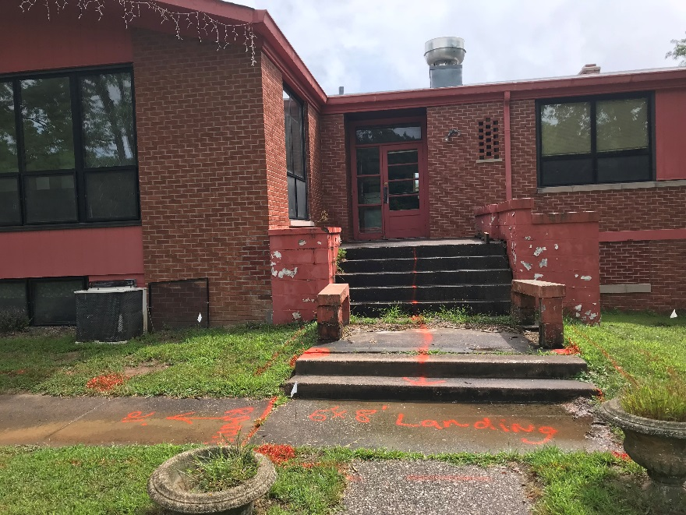
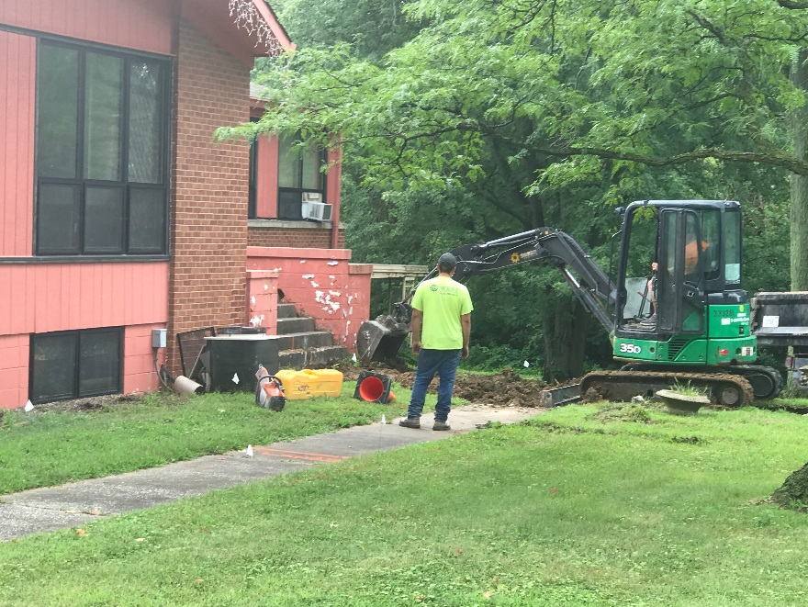
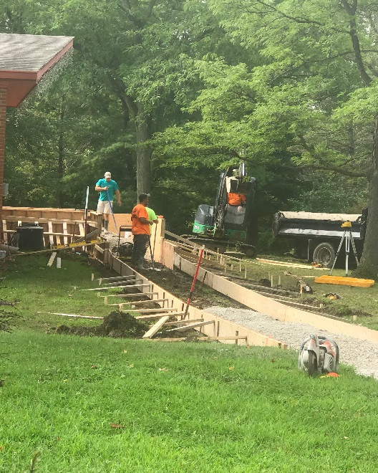
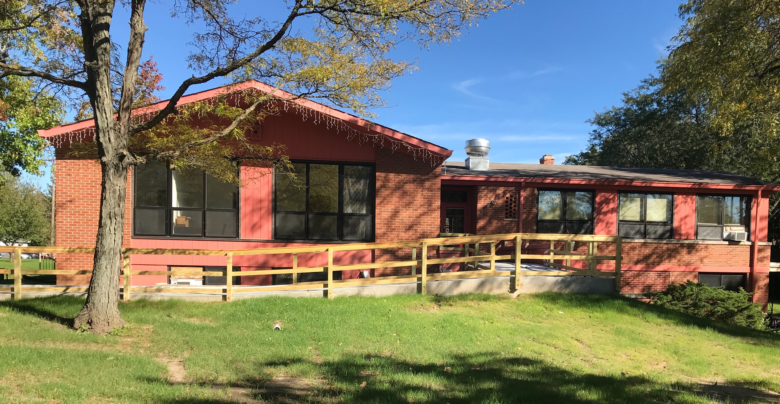
Project Outcomes
Rock Island County Council on Addictions
Notes:
Sarah slide

Slide 21
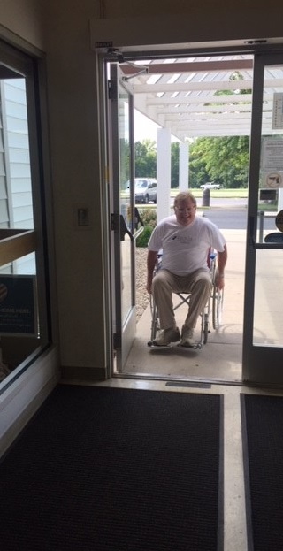
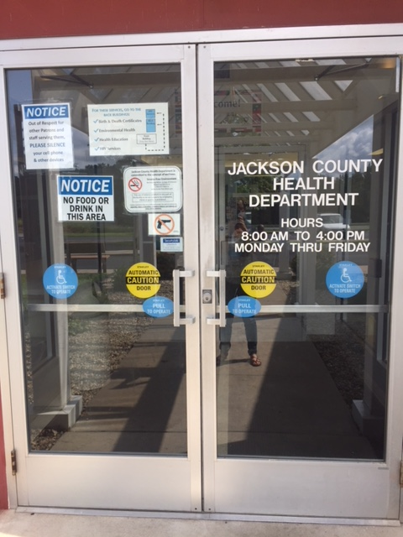
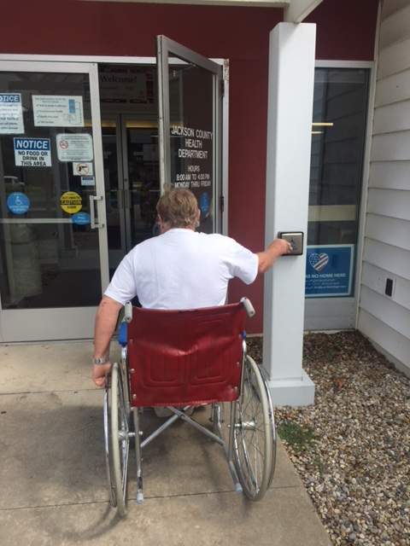
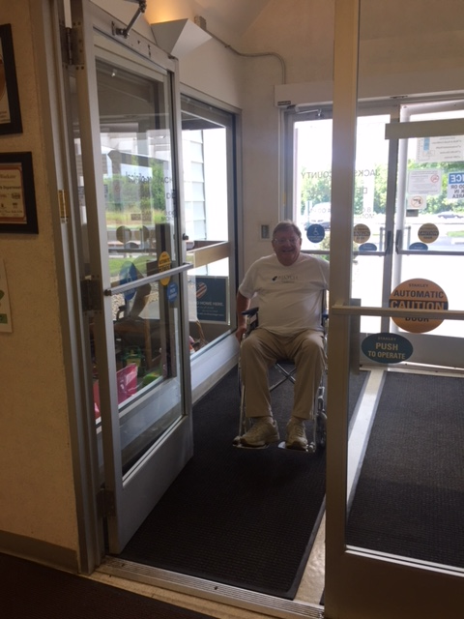
“Since the installation of our automatic doors, I have been pleased to notice more adult wheelchair patients in our facility receiving much needed services. I see this being a positive addition and great way to meet ALL members of our community. We would not have been able to make these upgrades to our facility at this time without the funds from this grant. Thank you again!” - Dr. Sarah Patrick, Administrator, Jackson County Health Department
Project Outcomes
Notes:
Sarah slide

Slide 22
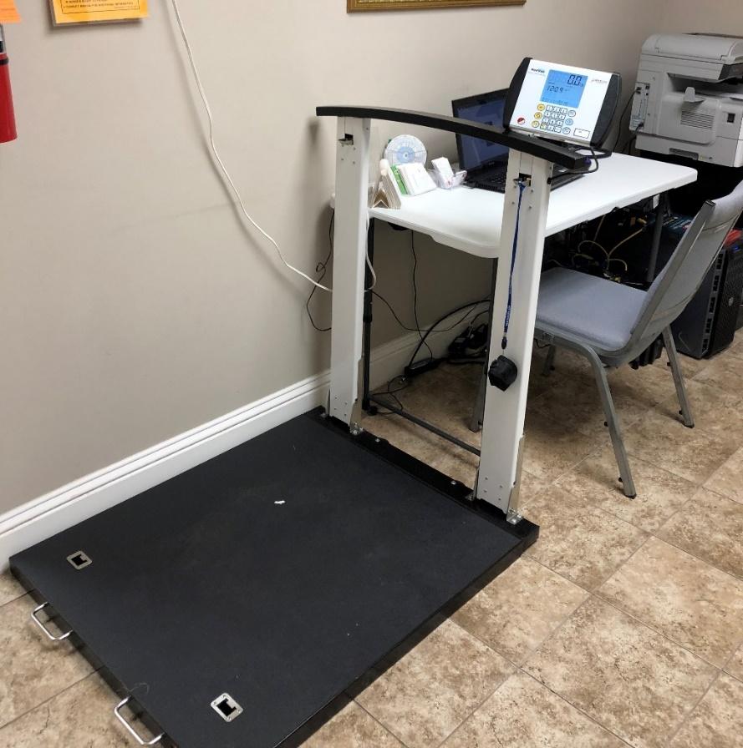
Project Outcomes
Roll-on scale
The UpScale M430. Combined accessible exam table and scale.
- Penne Jaster, Nurse Practitioner at Life Choices Medical Clinic
Notes:
Sarah slide

Slide 23
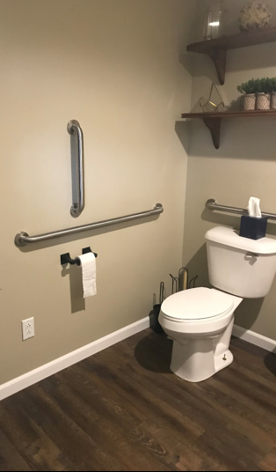
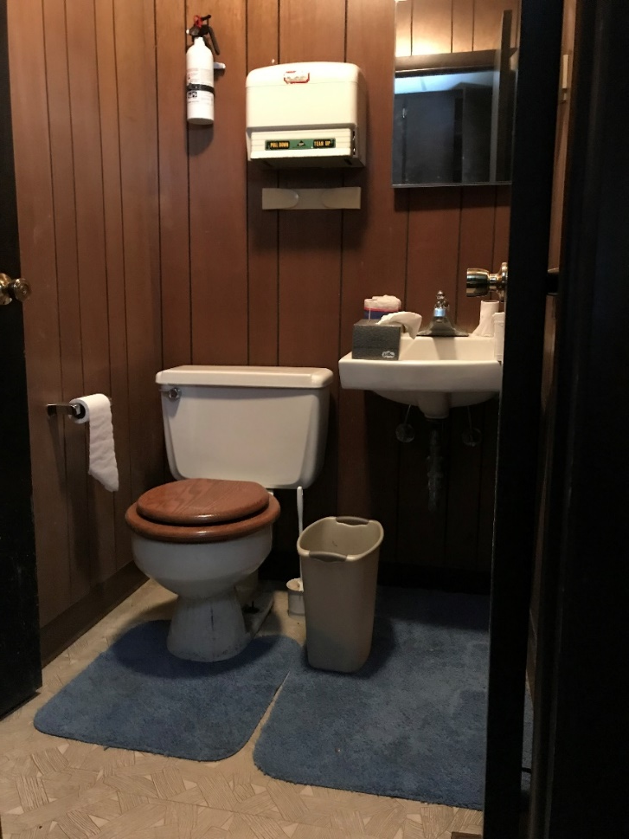
Project Outcomes
Before
After
“The existing bathroom was too small for clients with wheelchairs, mobility aids, and other power-driven mobility devices. Also there were no handrails for safe mobility. Having this ADA bathroom will allow Momentum Counseling to offer mental health and addiction services to those with wheelchairs, mobility aids, and other power-driven mobility devices.”
-- Michelle Salazar, LISW-S, LICDC-CS
Behavioral Health Clinician, Owner
Momentum Counseling & Consultation, LLC
Notes:
the grant was specifically for ADA related improvements of the restroom, parking lot, sound proofing, entrance, and vinyl flooring.
We at Momentum Counseling and Consultation, LLC are so blessed to be chosen for this grant. Our bathroom will now be accessible to people with disabilities. The existing bathroom was too small for clients with wheelchairs, mobility aids, and other power-driven mobility devices. Also there were no handrails for safe mobility. Having this ADA bathroom will allow Momentum Counseling to offer mental health and addiction services to those with wheelchairs, mobility aids, and other power-driven mobility devices.
I assume sound batting (like insulation) was added behind the drywall. That’s typically how that would be done, so it wouldn’t really be possible to get a picture after the walls have been closed up

Slide 24
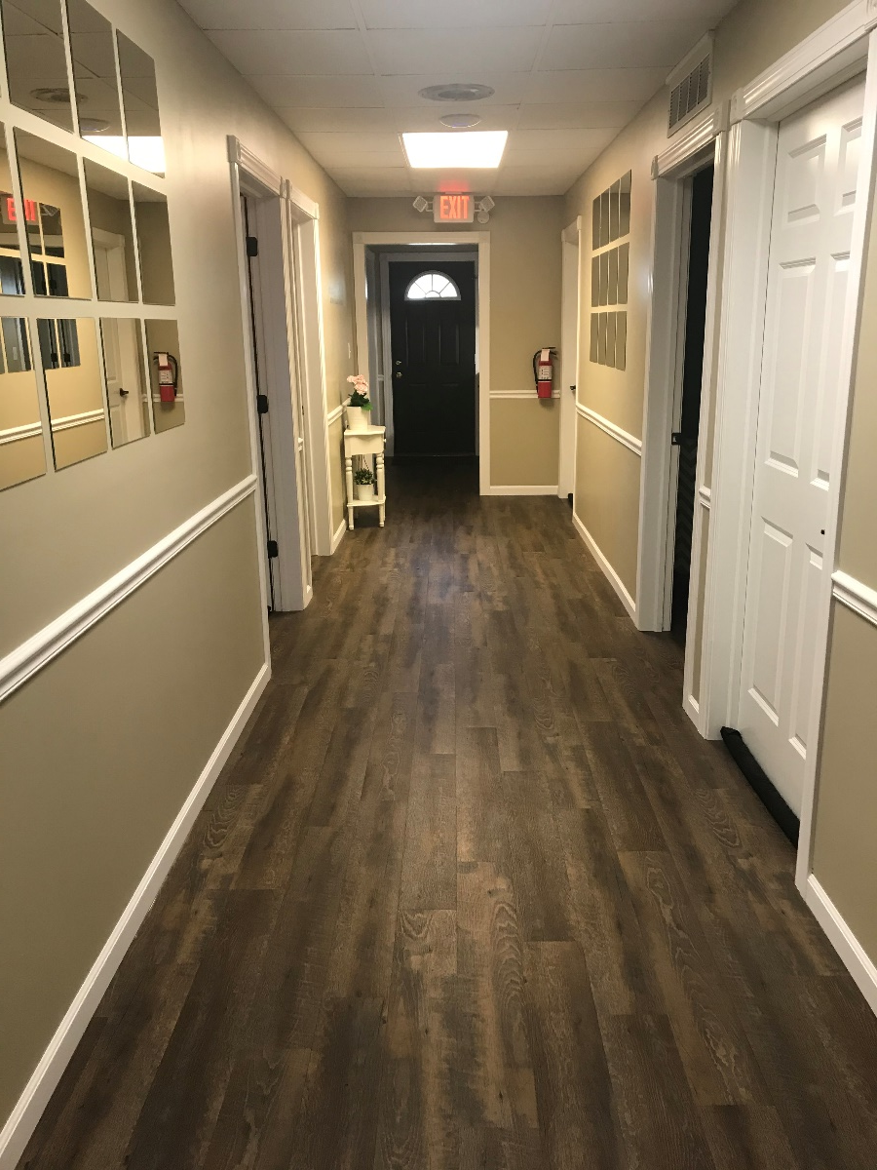
Project Outcomes
“Sound proofing offices through sound proof wall board will allow clients to feel comfortable sharing their symptoms and challenges. Client outcomes are improved when clients can accurately present symptoms and needs.”
-- Michelle Salazar, LISW-S, LICDC-CS
Behavioral Health Clinician, Owner
Momentum Counseling & Consultation, LLC

Slide 25
Project Outcomes: Programmatic Access
Noise Cancelling Headphones
Circadian Lighting
Video Remote Interpreting (rural location, 1 ASL interpreter)
Digital Annunciator for Elevator
Assistive Listening Devices
Braille Signage & Materials
Sound Proofing Walls
TV/DVD Sensory Accommodations
Weighted Stuffed Animals
Natural Lighting
Weighted Blankets
Notes:
Sarah slide

Slide 26
2018 Lessons Learned
Simultaneous Roll Out
Fund Disbursement
Provider Outreach
Notes:
Kelly/Sarah slide

Slide 27
Questions, Next Steps, Call to Action
Provider Accessibility Initiative

Slide 28
Questions
Audience questions
Call to Action
For advocates
For other health plans

Slide 29
Thank You
Please send any additional feedback or questions to:
Kait Campbell kaitlin.m.campbell@centene.com, 314-320-2562

